Slide 2
Sustainable sources of food: how can we grow oyster mushrooms?

Slide 3
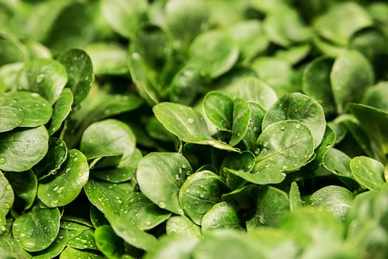
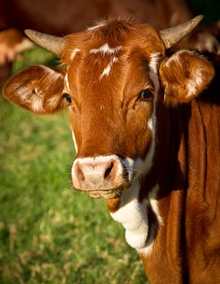
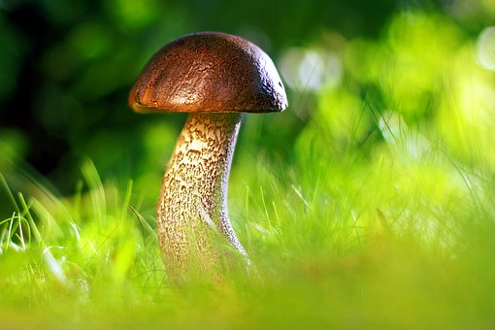
Which is the odd one out and why?
Notes:
Odd one out activities should promote thinking and discussion. Children should be encouraged to offer suggestions and possibilities, secure in the knowledge that there is absolutely no definite correct or incorrect answer to the question. Ask children to suggest as many different responses as they can and give reasons for each one. Odd one out activities are a great way to discover what children already know about a subject matter and also to uncover children’s misconceptions about science, in this case about materials. In this example, it is important for children to understand that mushrooms are not plants or animals, but fungi. A great video with some nice information on fungi at https://www.youtube.com/watch?v=Cm81u2xhsB8

Slide 4
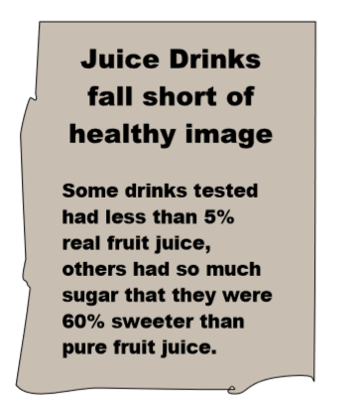
Popularity grows for ‘Meat-free Mondays’
There is a growing interest across the country for people to switch their meat dishes for vegetarian alternatives on one day per week.
The high levels of land and water used, and greenhouse gases produced, mean that cutting down on the amount of meat we eat is a key way that we can help tackle climate change.
How does the food we produce and eat have an impact on the environment?
What do you think about ‘meat-free Monday? Why?
Notes:
As a class, read the newspaper article about ‘Meat Free Monday’ and discuss the implications of turning to more sustainable sources of food as the population of our world continues to grow. Consider the question of how will we make sure that there is enough food to feed everyone not just now but in the future?
Discuss how the food we produce and eat has an impact on the environment. Many people today eat meat from animals, such as cows, pigs, chickens and sheep, but there is a growing opinion that meat production can have a negative impact on our environment.

Slide 5
Greenhouse gases are certain gases in the air, including carbon dioxide, that trap heat from the Sun, so it stays close to the Earth.
With all the fossil fuel that we burn, we are adding more greenhouse gases to the air. The result of this is that more heat gets trapped on Earth, causing it to warm up. Over many years, the temperature on Earth will increase and this is called climate change.

Slide 6
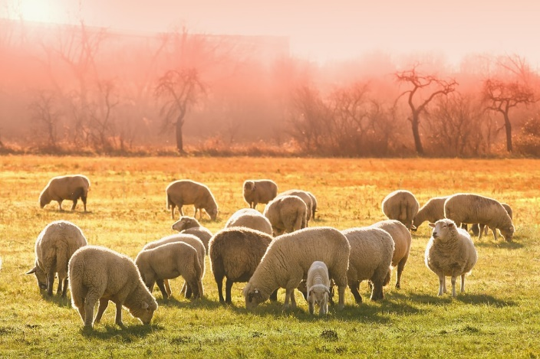
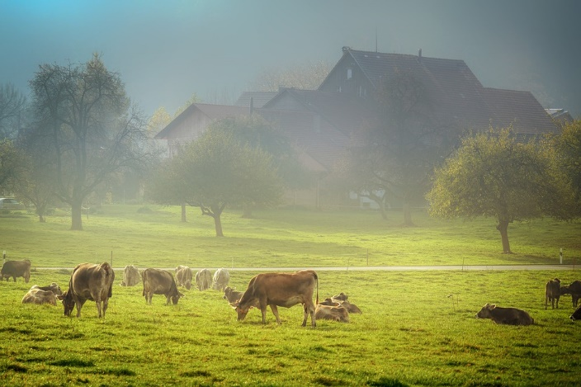
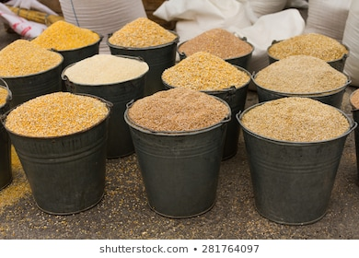
Did you know . . . ?
Nearly a third of the Earth’s land surface is used for raising animals for us to eat
Raising these animals produces harmful gases called greenhouse gases.
This can lead to the Earth gradually getting warmer – also known as climate change.
Millions of gallons of water are used for producing animal feeds.
Notes:
Explain that it requires a lot of land and water to raise animals. Discuss the facts and figures about land and water usage in relation to rearing livestock. Discuss that some people believe that the production of livestock releases harmful gases called greenhouse gases, such as methane from livestock digestion and nitrous oxide from producing animal feed, and this can lead to the Earth’s climate gradually getting warmer as these greenhouse gases trap the heat from the Sun, in a similar way to heat being trapped in a greenhouse. Explain that if cows were a country they would be the third largest emitter of carbon after US and China according to the World Resources Institute.
There is growing opinion that cutting down on the amount of meat, especially beef, we eat is one of the ways we can tackle climate change and also soil, air and water pollution. For further confirmation of this, the UN has named inefficiencies in animal agriculture as 'the world's most urgent problem‘.

Slide 7
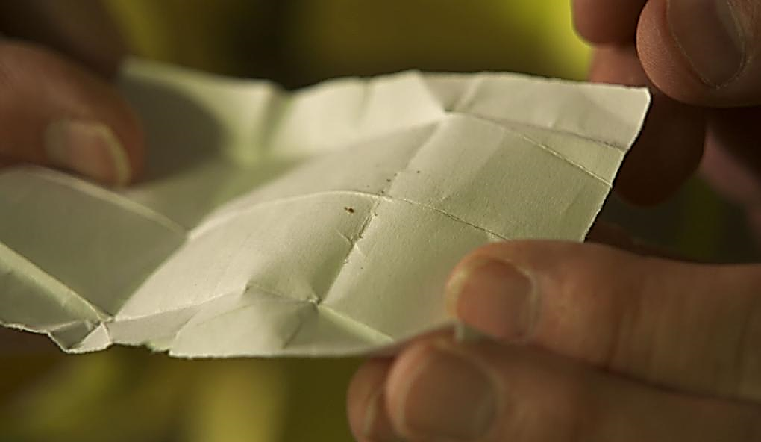
Rethinking food production: one company’s solution . . .
Scientists and engineers have found more sustainable ways to produce sources of food by using less land and water and creating fewer greenhouse gases.
By investigating the growth of certain types of fungi, scientists have produced a new type of food that can contain as much protein as milk and meat from animals!
Can you see the specks on the paper?
These are the spores of the fungi used to make the main ingredient in this new type of food.
Notes:
By examining the conditions required for certain types of fungi, similar to the oyster mushroom, to feed and grow, scientists have investigated another member of the fungi family and produced a new type of protein-rich food in a sustainable way. There is a good animation here about how Quorn is made which might be useful: https://www.youtube.com/watch?v=3wlprJOfNDA
Explain to children that it is difficult to find an image of the fungi 'growing' as such because it all happens in solution in special tanks called fermenters. The image on the slide shows this as the tiny beginnings – children will be able to link this to the spores they used in the growing oyster mushrooms main activity.

Slide 8
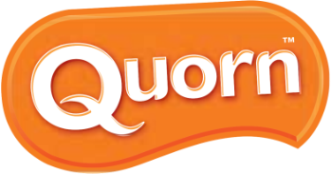
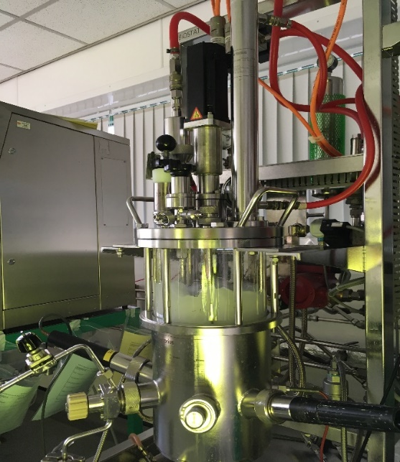
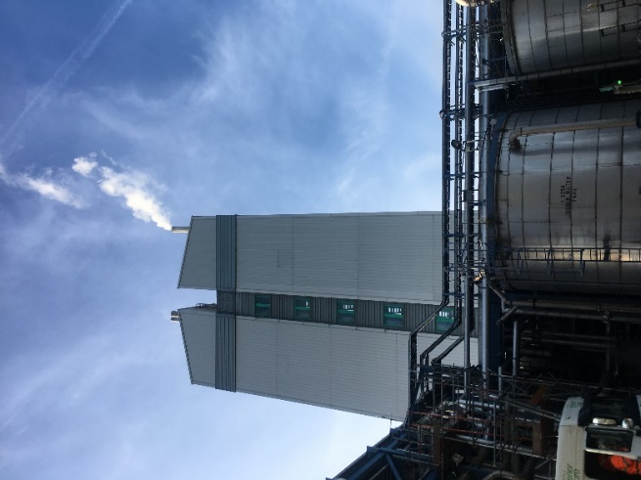
Companies like Quorn in Billingham, north-east England, produce a sustainable protein from fungi.
It is harvested then fermented using the same method used to make bread, beer and yoghurts. It is then cooked with egg whites, yeast and flavourings to produce a dough. Finally it is frozen to create a meat-like texture and then used as an ingredient in their food products.
Many people say that it looks like meat and tastes like meat and so is an excellent substitute made in a heathier, more environmentally friendly way.
Quorn Video Link
Notes:
Quorn’s fungi was originally discovered in the soil in Buckinghamshire and the company now cultures it in their factories.

Slide 9
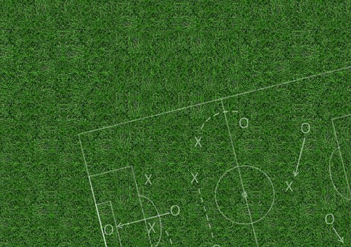
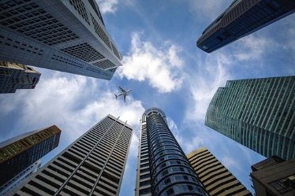
Thanks to companies like this, alternative sources of protein are also high in fibre and use 90% less land and water and have a smaller carbon footprint.
It has been reported that if 1000 people ate alternative products instead of ground beef, once a week for a year, the land saved would be the same as . . . .
nearly 22 sports fields!
52 round trip flights between London and New York!
and the carbon dioxide savings would be the same as . . .
Notes:
It is important to note that this new type of food is also high in fibre which is important for health, and which we cannot get from animal proteins.
There are some amazing statistics around like the ones on this slide . . . children may wish to research some of their own facts and figures.

Slide 10
www.ciec.org.uk

